Slide 1


Lecture 2
Indexing

Slide 2
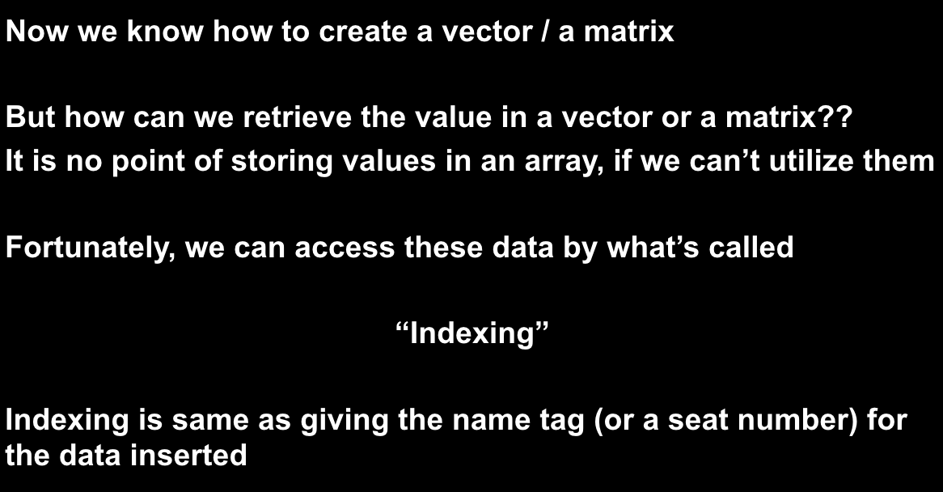
Indexing

Slide 3
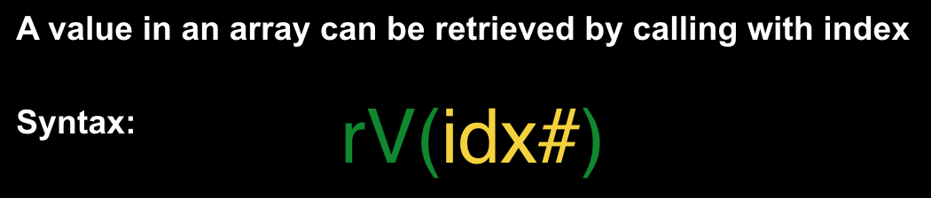
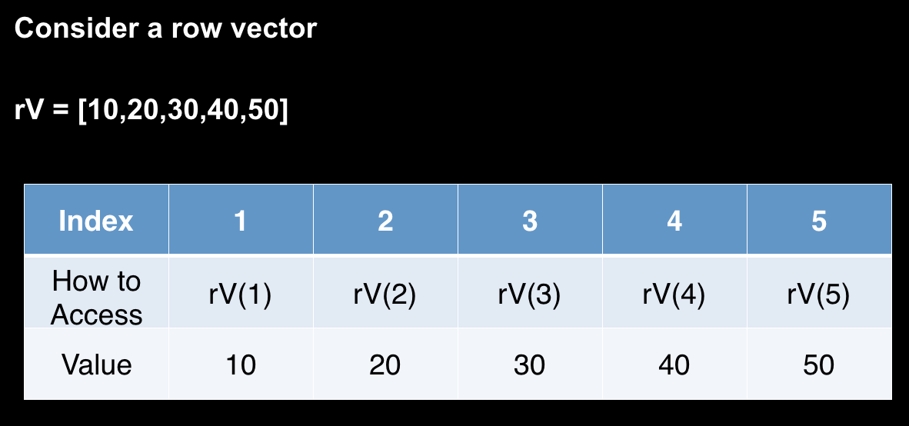
Indexing

Slide 4
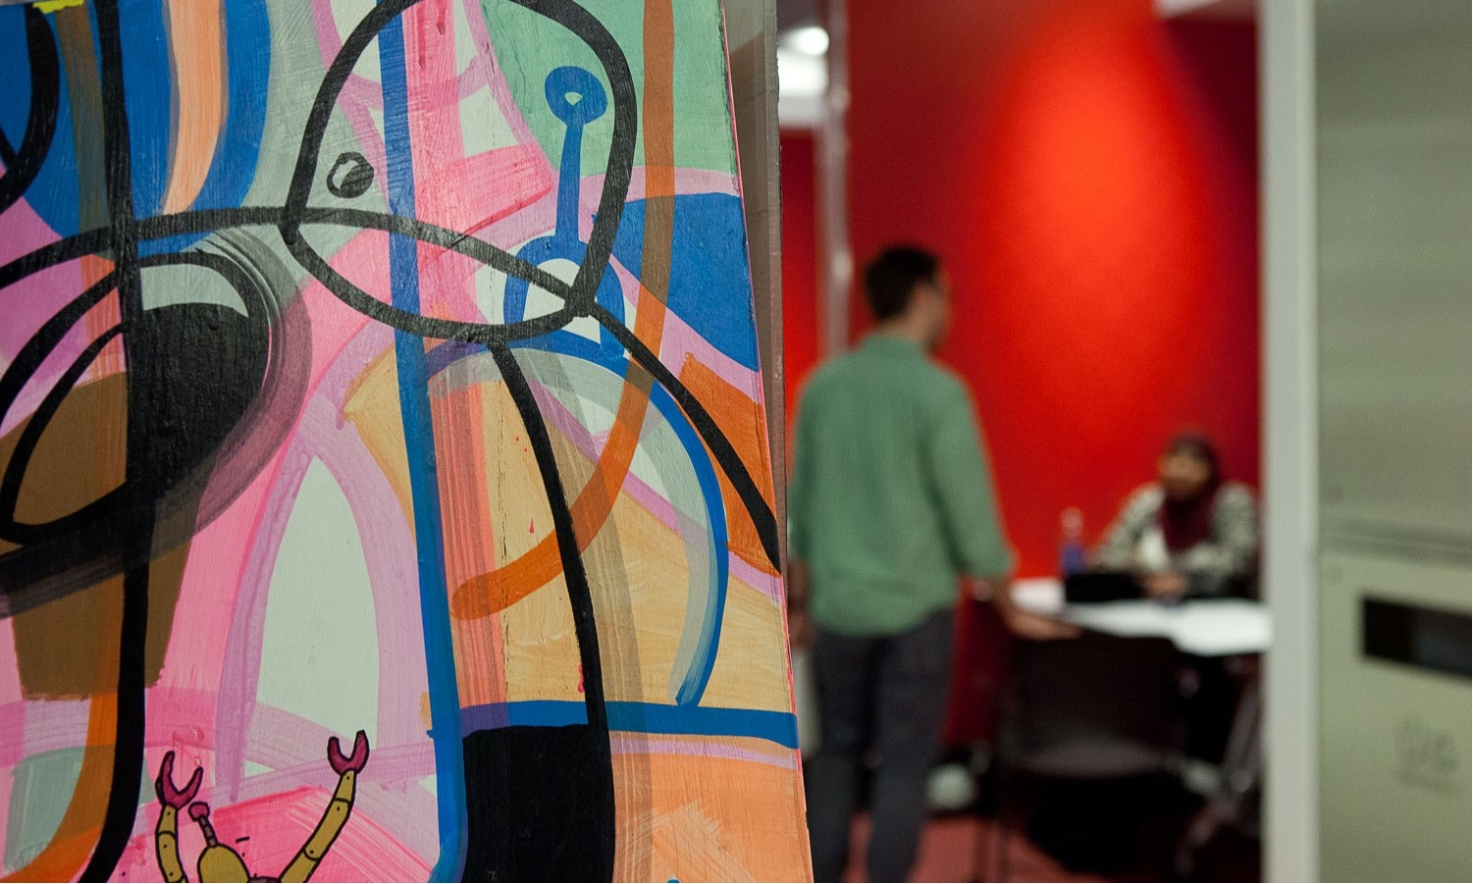

  Presenter Name | Department or School Name | Date
Since a matrix is 2D-array, two index can be utilized to extract the desired data
Syntax:
mat1(row#,col#)

Slide 5
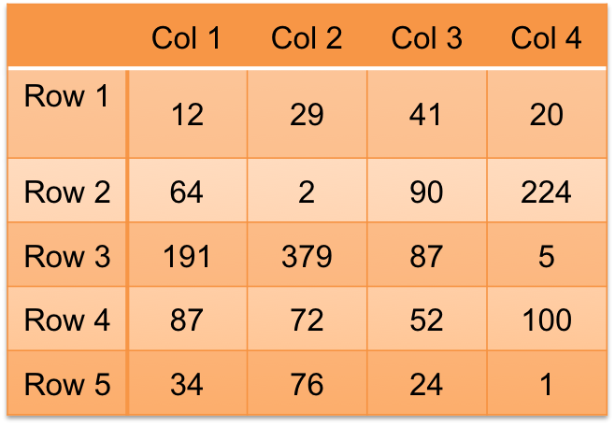
  Presenter Name | Department or School Name | Date
Let’s consider below 5 x 4 matrix
Mat1(4,2)
Mat1(1,3)
Mat1(2,2)
Mat1(5,3)

Slide 6
  Presenter Name | Department or School Name | Date
What if… I want to extract more than one data?
You CAN extract multiple data, but it has to be in sequence
First, the syntax:
mat1(_____,_____)
Row Index
Column Index

Slide 7
  Presenter Name | Department or School Name | Date
Multiple rows or columns can be selected using colon (:)
Both numbers are inclusive:
For example,
Returns 1st to 2nd Row and 1st to 2nd column of mat1
Depends on returning value, MATLAB returns either scalar, vector or matrix
Start #:End#
mat1(1:2,1:2)

Slide 8
  Presenter Name | Department or School Name | Date
If you omit numbers and place colon(:) only, then it returns the whole row or column
mat1(1:2,:)
mat1(:,1:2)
mat1(:,:)

Slide 9
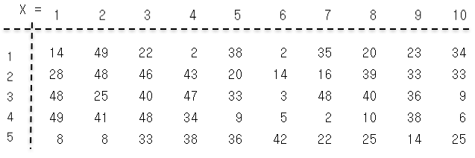
  Presenter Name | Department or School Name | Date
X(1:3,4:6)
X(3,9:10)
X(3:5,5:10)
X(2:4,:)
X(:,2:3)

Slide 10
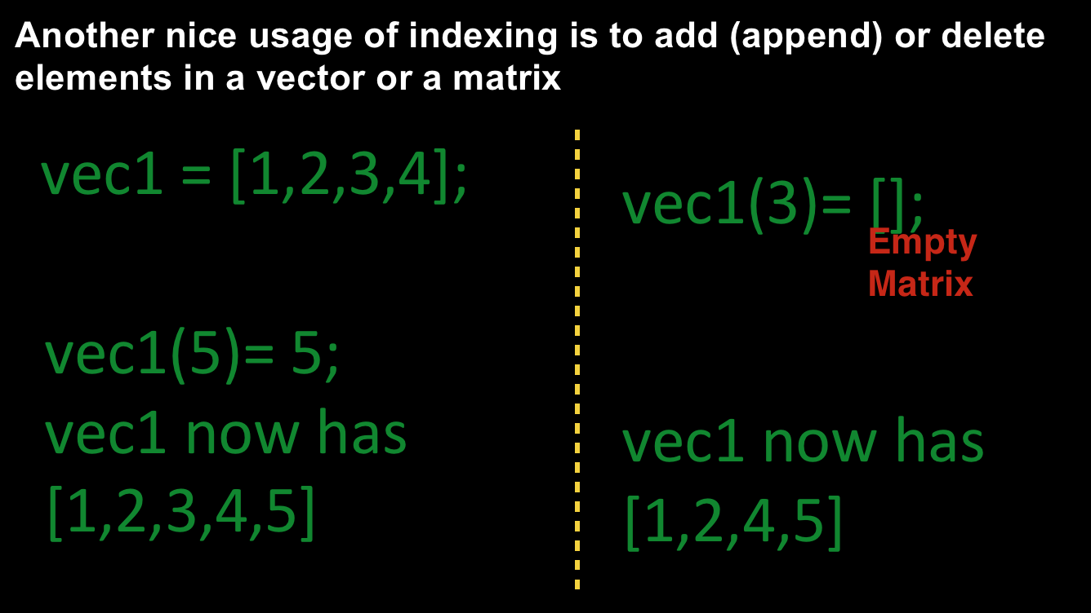
Indexing

Slide 11
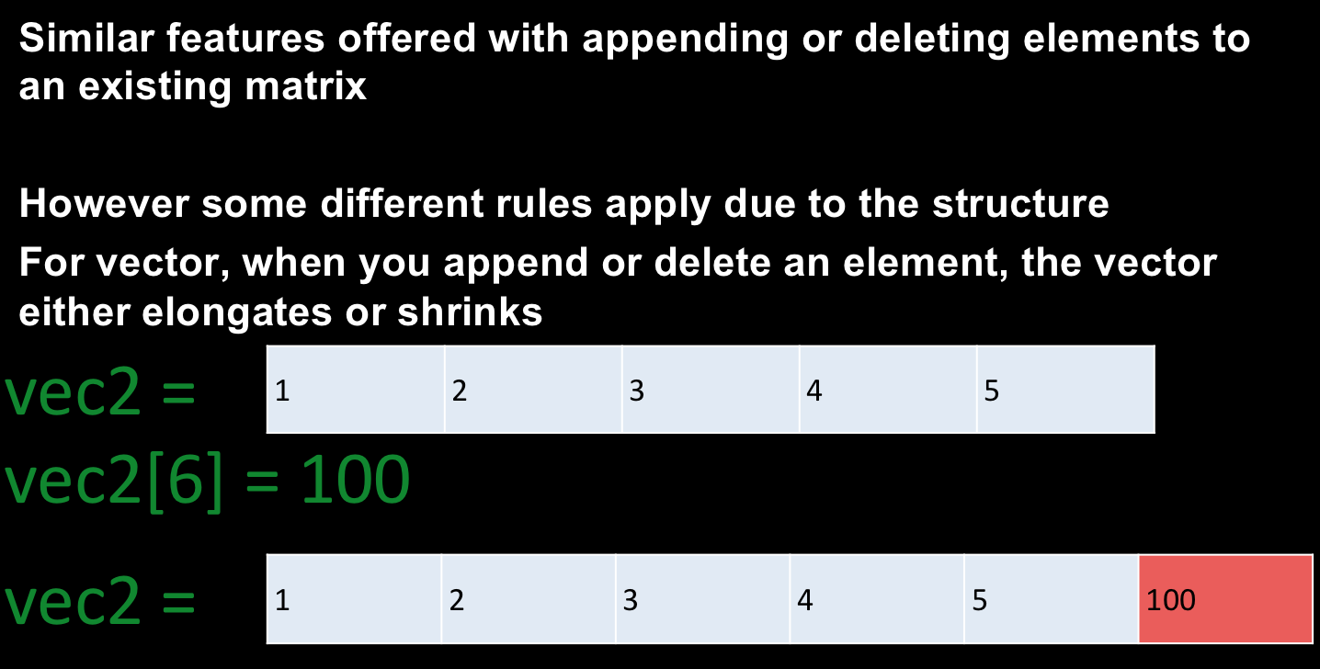
Indexing

Slide 12
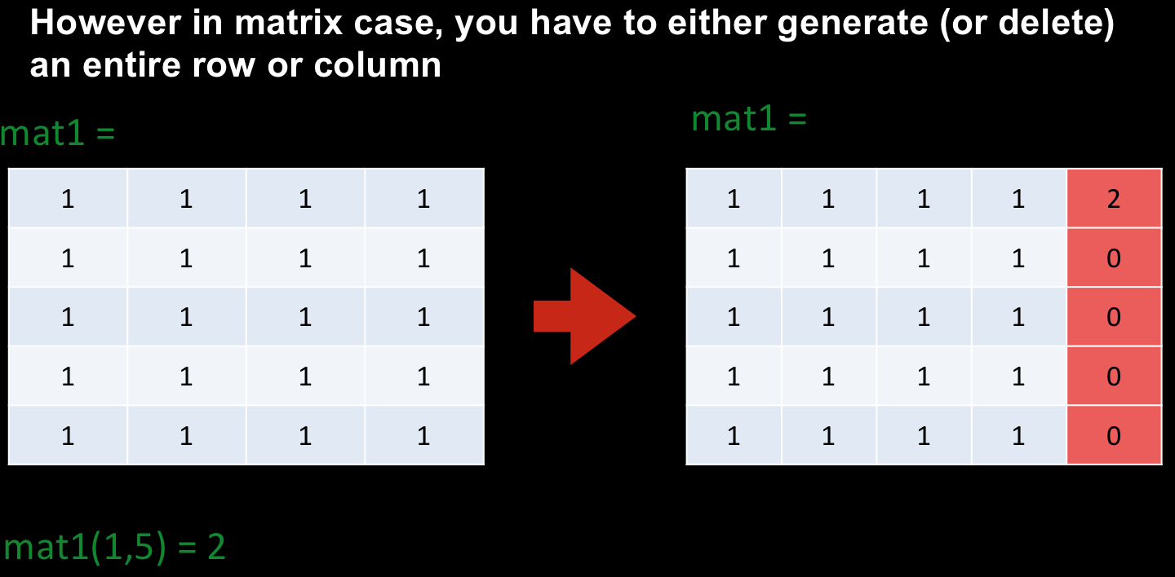
Indexing

Slide 13
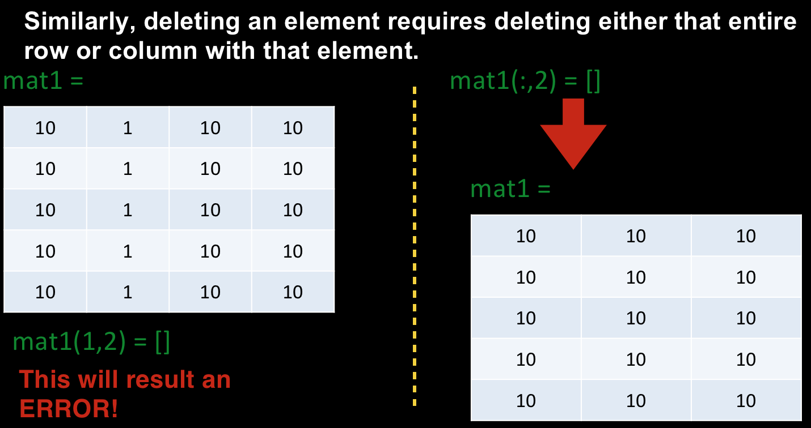
Indexing

Slide 14
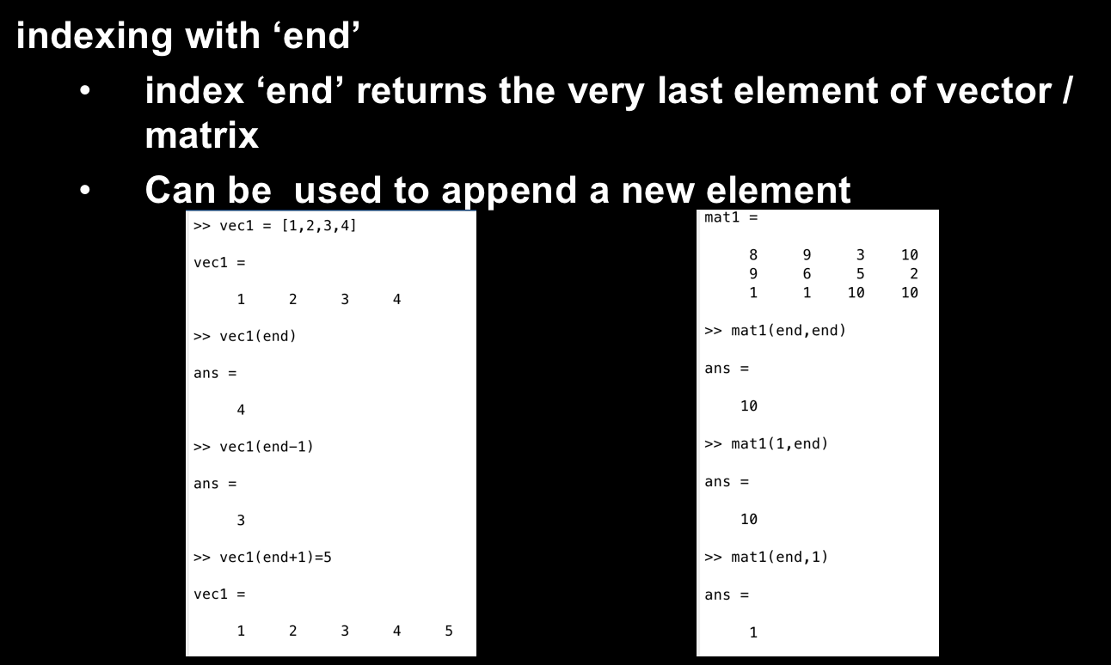
Indexing

Slide 15
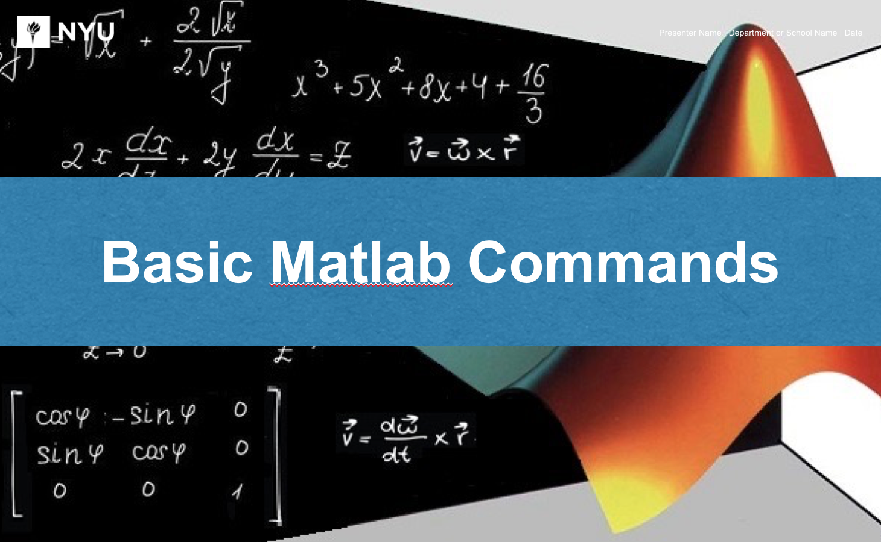
Basic MATLAB Commands

Slide 16
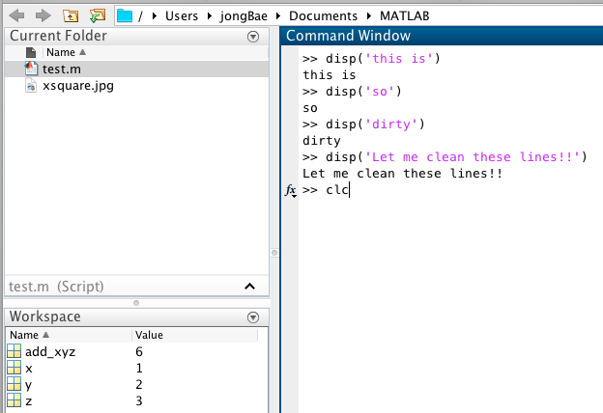
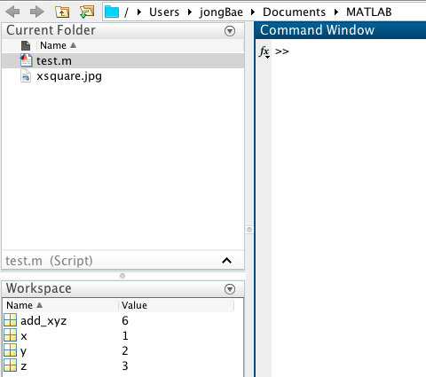
  Presenter Name | Department or School Name | Date
clc & clear

Slide 17
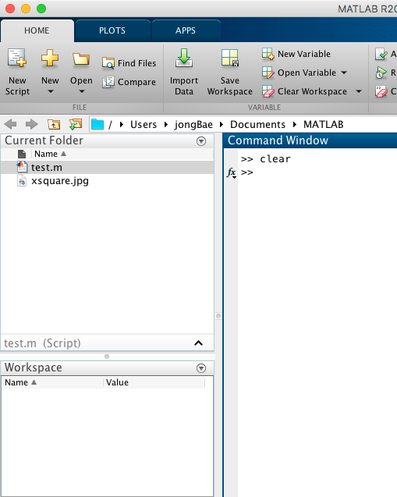
  Presenter Name | Department or School Name | Date
clc & clear

Slide 18
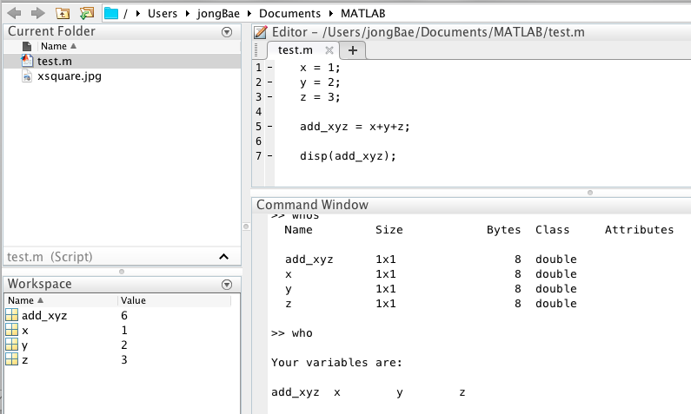
  Presenter Name | Department or School Name | Date
who / whos

Slide 19
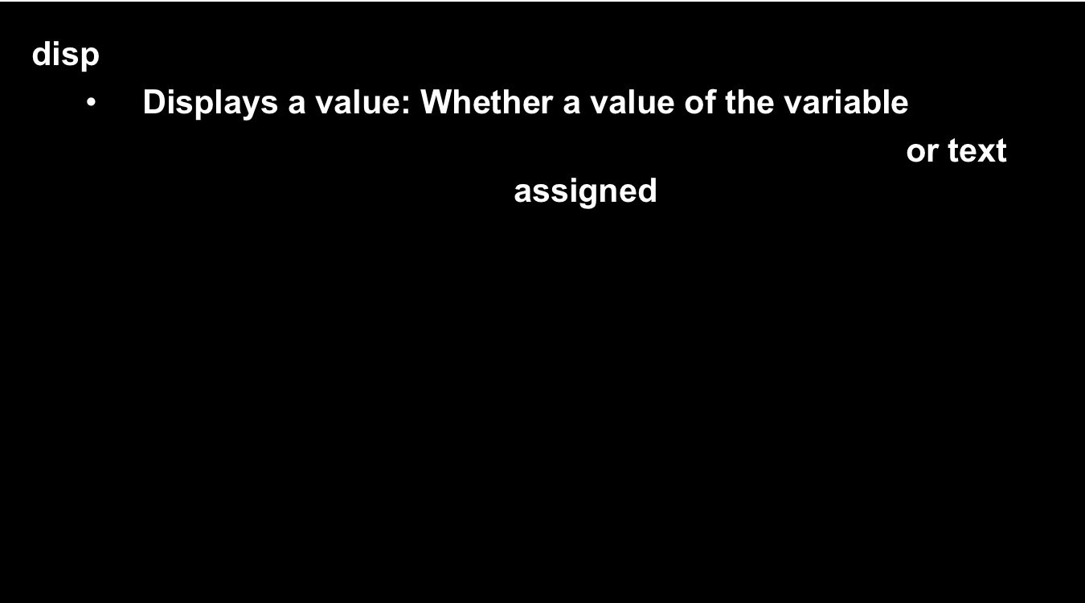
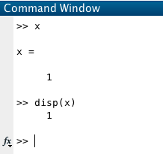

  Presenter Name | Department or School Name | Date

Slide 20
  Presenter Name | Department or School Name | Date
disp + num2str
  This combination allows to print characters w/ numbers
  Basically creating an array containing texts
  num2str converts number to string
disp([‘I am’ , num2str(20), ‘years old’])

Slide 21
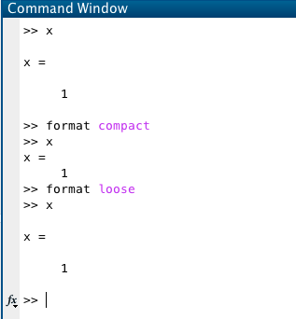
  Presenter Name | Department or School Name | Date
format (Spacing Format)

Slide 22
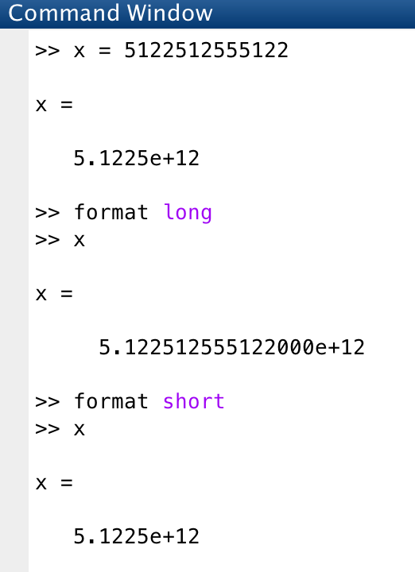
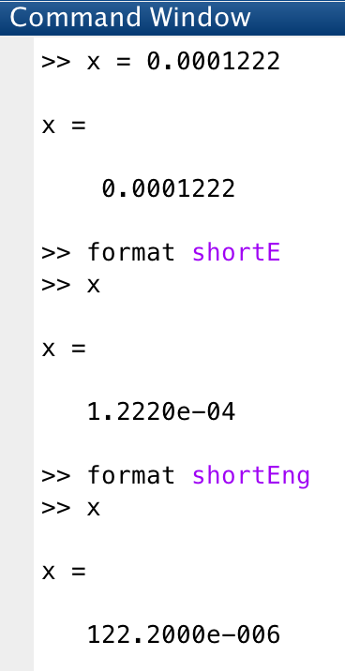
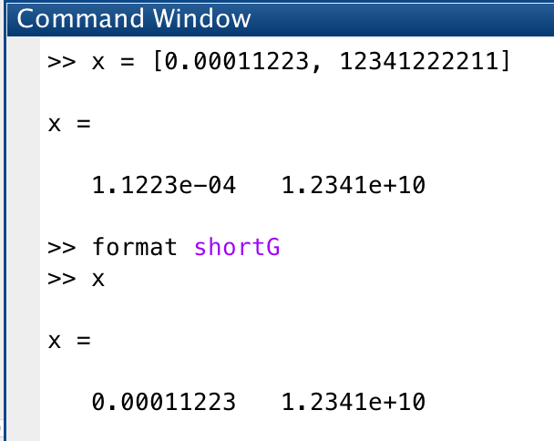
  Presenter Name | Department or School Name | Date
format (Numeric Format)

Slide 23
  Presenter Name | Department or School Name | Date
input
  Receives an input from the user
  The input from the user can be saved to a variable for the future use
Syntax:
input(‘ Prompt ’)

Slide 24
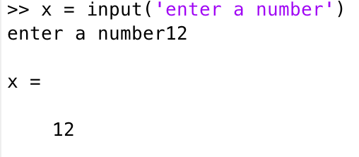
  Presenter Name | Department or School Name | Date

Slide 25
  Presenter Name | Department or School Name | Date
Quick Exercise
Using “disp” function and “input” function,
Ask for an input from the user, a number between 1-10
Then print it on the screen!
Like This:
“You have entered __. Right?”

Slide 26
  Presenter Name | Department or School Name | Date
Some trivial math expressions.
  π (pi) : pi
  e (exponential) = exp()
  ex: e^2 : exp(2)
  e^3 : exp(3)
  √ (Square-root) : sqrt()
  ex: √3 : sqrt(3)

Slide 27
  Presenter Name | Department or School Name | Date
Some trivial math expressions.
  ln (natural log) : log()
  log (log based 10): log10()

Slide 28
  Presenter Name | Department or School Name | Date
And….
YOUR BEST FRIEND : help
  help function_name
  ex: help input
  This will give you the explanation / syntax / examples for that function

